Slide 1

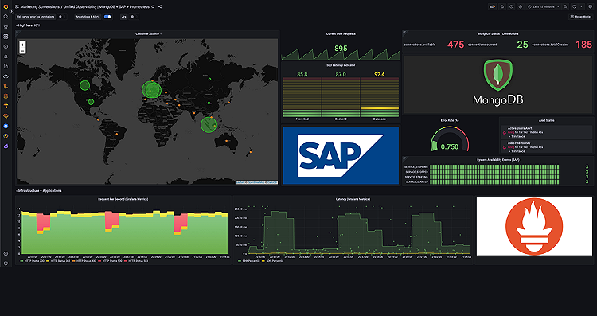
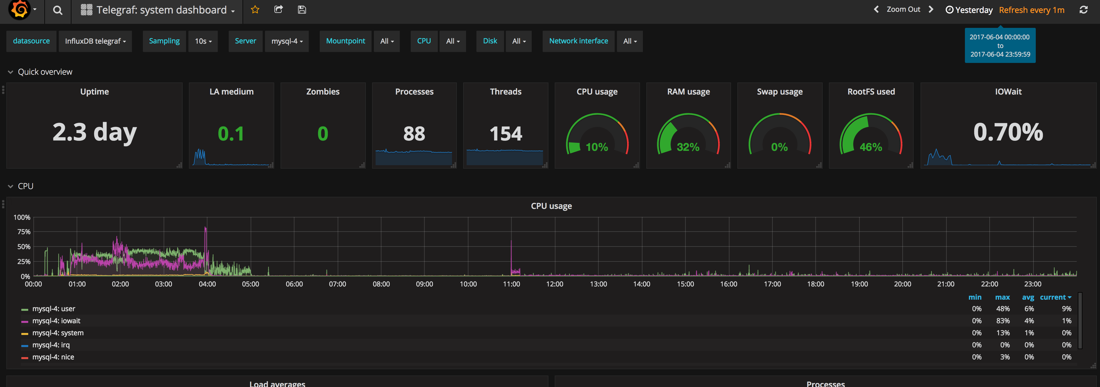
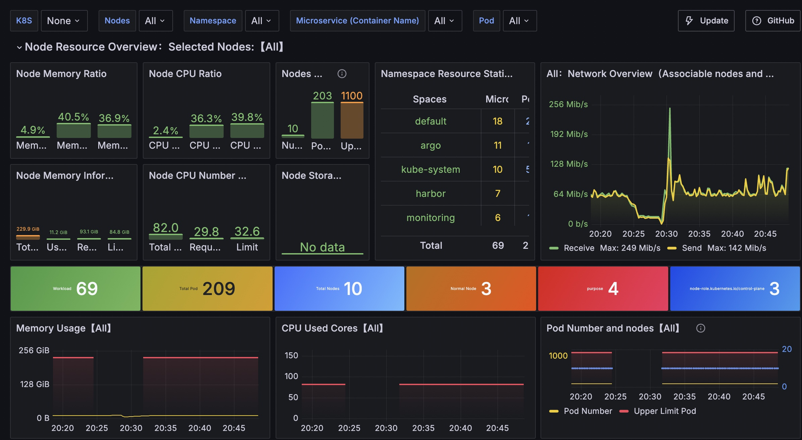
OBSERVABILITY · BUDGET REQUEST
The case for Grafana + Prometheus
Product and client environments run with no centralized monitoring today. This paper requests budget to fix that.
The problem
The proposal
The ask
No dashboards, no alerting, no historical view – issues surface from customers, not from us.
Stand up a self-hosted Grafana + Prometheus stack across product and client environments.
Approve a small recurring infra budget to host the stack (the software itself is free).
Observability business case · Grafana + Prometheus
1

Slide 2
SCENE SETTING
Growing footprint, no visibility
Scaling across product and client environments has outgrown manual checks and after-the-fact fixes.
✕
TODAY
✓
WITH GRAFANA + PROMETHEUS
✕
Reactive: we find out from a customer or a support ticket
✓
Proactive: alert rules page the right person automatically
✕
Logs scattered across servers, checked manually
✓
One time-series store for product and client environments
✕
No dashboards – every health check is a person, not a system
✓
Dashboards give a live, shared view of system health
✕
No alerting – nobody is paged before customers notice
✓
Historical data makes root-causing incidents faster
Observability business case · Grafana + Prometheus
2

Slide 3
THE MECHANISM
Two tools, two distinct jobs
Prometheus is the backend that collects and stores metrics. Grafana is the frontend that visualizes them.
✓
PROMETHEUS – THE BACKEND
✓
GRAFANA – THE FRONTEND
✓
Pull model: scrapes metrics from apps on an interval
✓
Visualization layer – doesn't collect or store metrics itself
✓
Stores everything itself as time-series data
✓
Connects to many data sources: Prometheus, MySQL, Elasticsearch, and more
✓
Queried with PromQL
✓
Builds the drag-and-drop graphs and dashboards
✓
Handles deep infrastructure alerting
⚑
Both tools are open source (Apache 2.0 / AGPL) and run today at companies of every size – proven, boring infrastructure, not a bet on a new vendor.
Observability business case · Grafana + Prometheus
3

Slide 4
COST
What this actually costs
The software is free. The ask is infrastructure to run it, sized for a small footprint (1–5 servers/services).
Software license
Hosting (estimate)
Storage (estimate)
$0. Prometheus and Grafana OSS are both free, open-source software.
~$30–50/month for a small VM running both services, at this scale.
~$5–10/month for a metrics retention volume, depending on retention window.
Setup time
Ongoing upkeep
Total (estimate)
Estimated 2–4 engineer-days to instrument services and build initial dashboards.
Estimated 2–3 hours/month – updates, dashboard tuning, alert-rule review.
Roughly $35–60/month in infra, plus a one-time setup cost. Ranges to be confirmed against actual cloud quotes.
!
Grafana Cloud's free tier (10k series, 14-day retention) may cover this footprint at $0 – worth checking before committing to self-hosted infra spend.
Observability business case · Grafana + Prometheus
4

Slide 5
ROLLOUT
A phased rollout, starting small
Prove value on the current footprint before expanding coverage.
1
Instrument core services
2
Build shared dashboards
3
Turn on alerting
Stand up Prometheus, connect it to the current 1–5 servers across product and client environments.
Grafana dashboards for the metrics that matter most today – uptime, latency, error rates.
Alert rules for the incidents that currently reach us only through a customer.
Observability business case · Grafana + Prometheus
5

Slide 6
CONCLUSION
Recommendation and ask
A small, proven investment closes a real visibility gap before it costs a customer.
Build vs. buy
Proven at scale
A custom monitoring build would cost engineering months. Grafana + Prometheus does it for ~$40/month in infra.
This is the default observability stack for teams from small startups to large platforms – not an experimental choice.
The ask
Sign-off
~$35–$60/mo infra budget
CFO
!
Self-hosting means the team owns maintenance and uptime of the monitoring stack itself – budget the 2–3 hrs/month upkeep, or revisit Grafana Cloud if that overhead isn't worth taking on.
Observability business case · Grafana + Prometheus
6

